Slide 1


The Genotype Ontology
An OWL Model for the Integration and Analysis of G2P Data
Matthew Brush
The Monarch Initiative
https://monarchinitiative.org/
Ontology PURL: http://purl.obolibrary.org/obo/geno.owl

Slide 2
GENO Overview
Coverage
Genotypes and their component elements of genetic variation (across human and model organism G2P databases)
Additional terms needed to describe these elements and represent G2P associations (e.g. environmental context, evidence/provenance)
Goal
Support integration and analysis of G2P data from diverse sources and species under a unified semantic framework
Development
Openly developed on Github (link) under Monarch Initiative organization
Aligned with OBO Foundry principles, under BFO framework
Reuses terms from existing models (SO, FALDO, OBAN, IAO, GO, OBI, SEPIO)
Development thus far driven primarily by Monarch data and use cases

Slide 3
GENO in Monarch
Part of Monarch ontology import chain loaded into SciGraph
Provides ontology terms and design patterns used to structure rdf graphs generated from source data through DIPper pipeline
Leveraged by Cypher queries to serve data to Monarch website and services
Encodes logic that supports analysis and inference use cases driven by Monarch Initiative tools and algorithms (e.g. phenotype propagation)

Slide 4
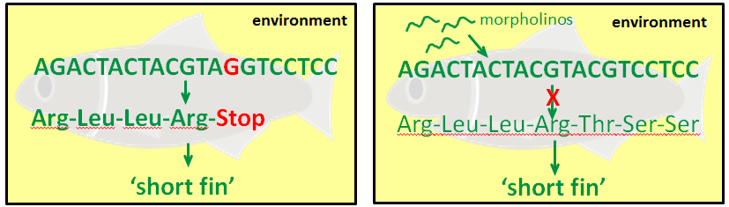
Intrinsic vs Extrinsic Genotypes
The concept of a ‘genotype’ in GENO is viewed broadly to apply to any variation in genomic sequence or variation in gene expression that is tied to an observed phenotypic effect. We distinguish three categories of genotypes:
Intrinsic genotypes describe variation in the genomic sequence (e.g. pt. mut, deletion., transgenic ins.).
Extrinsic genotypes describe variation in gene expression (resulting from gene targeting technologies such as RNAi, morpholinos).
Effective genotypes describe total variation in gene sequence or expression (intrinsic + extrinsic)
SEQUENCE-VARIATION
EXPRESSION-VARIATION
‘Intrinsic’ Genotype
‘Extrinsic’ Genotype
fgf8^{ti282a/ti282a}(AB)
+
shhb^{MO1-shhb}
‘Effective’ Genotype
fgf8^{ti282a/ti282a}(AB); shhb^{MO1-shhb}
Notes:
A unique aspect of GENO is that it views genotypes broadly to apply to any variation in gene expression that is tied to an observed phenotypic effect. Here we distinguish two types of variation.
The traditional view of genotypes describes inherent variation in genomic sequences. A simple example of such sequence variation is a point mutation that causes premature truncation of a protein, and might lead to a fish having a short fin. In GENO we refer to such genotypes as being ‘intrinsic’.
With the advent of molecular biology techniques for target genes using reagents such as morpholinos, variation in gene expression can be induced at the time of an experiment without altering intrinsic genomic sequence. This expression-level-variation is the other major form of alteration that can be described using GENO. Here, targeting a WT version of this same gene with a morpholino can lead to the same phenotype of having a short fin. In GENO we describe such variation in an artifact called an ‘extrinsic’ genotype. These are structured and broken down in an analogous fashion as an intrinsic genotype. And syntactically, their representations are presented to users in a format that mirrors a traditional genotype – with targeting reagents being superscripted above gene names to indicate how each gene varies in its expression from WT.

Slide 5
Intrinsic Genotype Partonomy
An ‘intrinsic’ genotype is decomposed into its more fundamental components of variation. These represent the ‘levels’ of a genotype at which phenotype associations are made.
AACGTAGCGACGCTCGCTACGGGCGTATC
AACGTAGCGACGCTCGCTACGGGCGTATC
CGTAGC
X
=
X
AACGTACCGACGCTCGCTACGGGCGTATC
AACGTACCGACGCTCGCTACGGGCGTATC
+
CGTACC
X
X
ACAC
GCGAAGTGCCAACTTCTACACACACAAAG
GCGAAGTGCCAACTTCTACACACACAAAG
X
X
ACAC
GCGAAGTGCCAACTTCTACACACACAAAG
GCGAAGTGCCAACTTCTACACACACAAAG
intrinsic genotype
genomic background
genomic variation
complement
apc^{hu745/+}; fgfa8^{ti282a/ti282a}(AB)
(AB)
apc^{hu745/+}; fgf8a^{ti282a/ti282a}
X
genomic variation
complement (gvc)
apc^{hu745/+}; fgf8a^{ti282a/ti282a}
X
X
*
has_part
has_part
X
variant single locus
complement (vslc)
fgf8a^{ti282a/ti282a}
has_part
has_part
X
variant allele
fgf8a^{ti282a}
has_part
has_part
X
sequence alteration
ti282a
* Breakdown of only the fgf8a locus is shown here, but the apc locus variation is similarly decomposed in the GENO model
Notes:
Intrinsic genotypes specify genomic changes across an entire genome sequence - in terms of its variation from some reference genome. The core of GENO is a partonomy that “decomposes” a complete intrinsic genotype into its smaller components.
This figure shows a GENO representation of a zebrafish genotype containing two altered loci – a heterozygous point mutation in the apc gene (hu745), and a homozygous point mutation in the shha gene (ti282a). GENO classes are shown in blue along with a schematic of the genomic sequence they specify, and the part_of relations between them. Relations are shown in italics, and an example instance of each class from a zebrafish genotype are show in green.
The top level breakdown decomposes a complete genotype into a genomic background, which is a characterized reference genome, and a genomic variation complement, which represents the allelic composition of each variant in the genome. This genotype contains a heterozygous mutation at the apc gene, and homozygous mutation of the fgf8a gene.
The second part of this figure shows how GENO further decomposes this genomic variation complement (shown here only for the fgf8a variant, but the apc variant would be similarly decomposed). It is first decomposed into individual variant single locus complements, and these complements are then split into its single variant alleles, which are then decomposed into specific sequence alterations that define the variation.
This partonomy of genotype components is the core of the GENO ontology. This is important to addressing the first role of GENO in Monarch of reconciling different levels of G2P associations, because these classes represent the different levels at which phenotypes are annotated in different G2P databases.

Slide 6
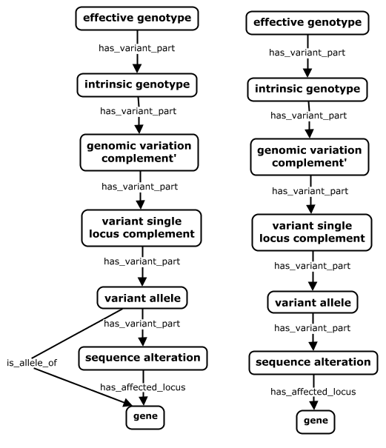
Genotype Partonomy
An ‘intrinsic’ genotype is decomposed into its more fundamental components of variation. These represent the ‘levels’ of a genotype at which phenotype associations are made.
Specifies the total variation in genomic sequence or gene expression across a genome.
fgf8a^{ti282a/ti282a};shha^{tbx392/+}[TL]; cdkn1ca^{MO3-cdkn1ca}
*
Specifies sequence variation across an entire genome in terms of its differences from some genomic background.
fgf8a^{ti282a/ti282a};shha^{tbx392/+}[TL]
The variant portion of a genome, comprised of all allelic complements containing at least one variant allele.
fgf8a^{ti282a/ti282a};shha^{tbx392/+}
The set of all alleles at a locus where at least one is variant
fgf8a^{ti282a/ti282a} | shha^{tbx392/+}
A single locus that contains a sequence alteration
fgf8a^{ti282a} | shha^{tbx392}
A single locus whose extent is the deviation from a reference .
ti282a | tbx392
A locus containing all elements needed to produce functional gene product
fgf8a | shha
Notes:
Definitions and examples for each level in the genotype partonomy.
* This cdkn1ca^{MO3-cdkn1ca} variant is a morpholino-targeted gene that is part of the extrinsic genotype. The breakdown in this figure shows only decomposition of the intrinsic genotype. Modeling of the extrinsic genotype is detailed in subsequent slides.
GENO models genotype ‘content’ with relatively precise granularity (i.e. explicit representation of distinct ‘levels’ of variation, and partonomic relationships between them) relative to other approaches. For example, Flybase treats genotypes merely as ‘bags of alleles’ – forgoing explicit representation of each level above. The GENO model is built this way to support two key use cases. The first is related to integration of G2P data across diverse systems and species – where phenotypes may be asserted at each of the levels of genetic variation described in the partonomy above. The second concerns the need to ‘propagate’ phenotypes up and/or down this partonomy – i.e. inferring associations between phenotypes and variant entities other than that where the phenotype as asserted to hang.

Slide 7
Genotype Modeling and Use Cases
Relative to other approaches*, GENO models genotype ‘content’ in greater detail – providing explicit representation of distinct ‘levels’ of variation, and partonomic relationships between them).
The GENO model is built this way to support two key use cases:
Integration of G2P data across diverse systems and species – where phenotypes may be asserted at each of the levels of genetic variation described in the partonomy above.
The need to ‘propagate’ phenotypes up and/or down this partonomy – i.e. inferring associations between phenotypes and variant entities other than that where the phenotype as asserted to hang.
Notes:
* For example, Flybase treats genotypes merely as ‘bags of alleles’ – forgoing explicit representation of each level above.

Slide 8
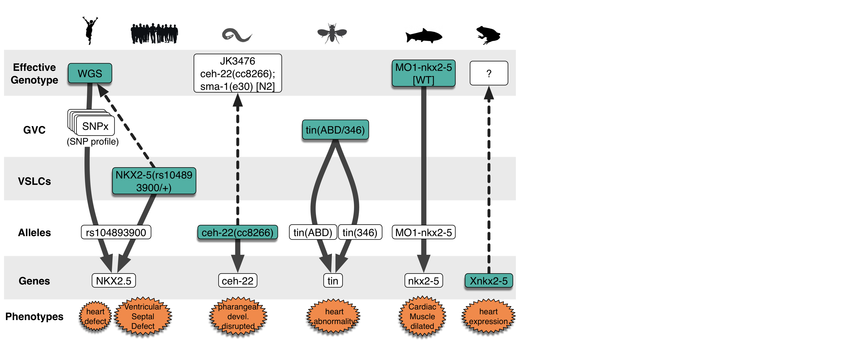
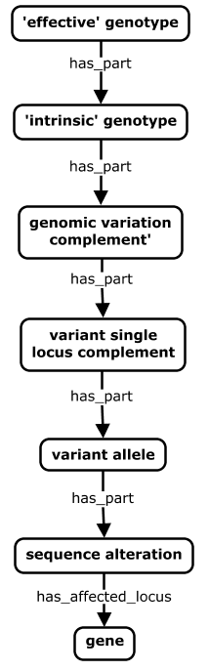

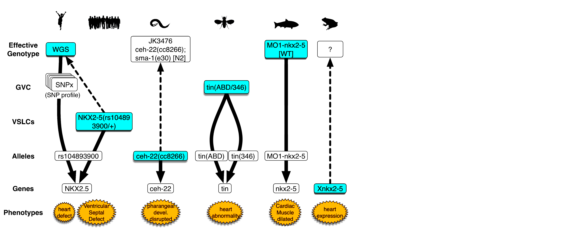

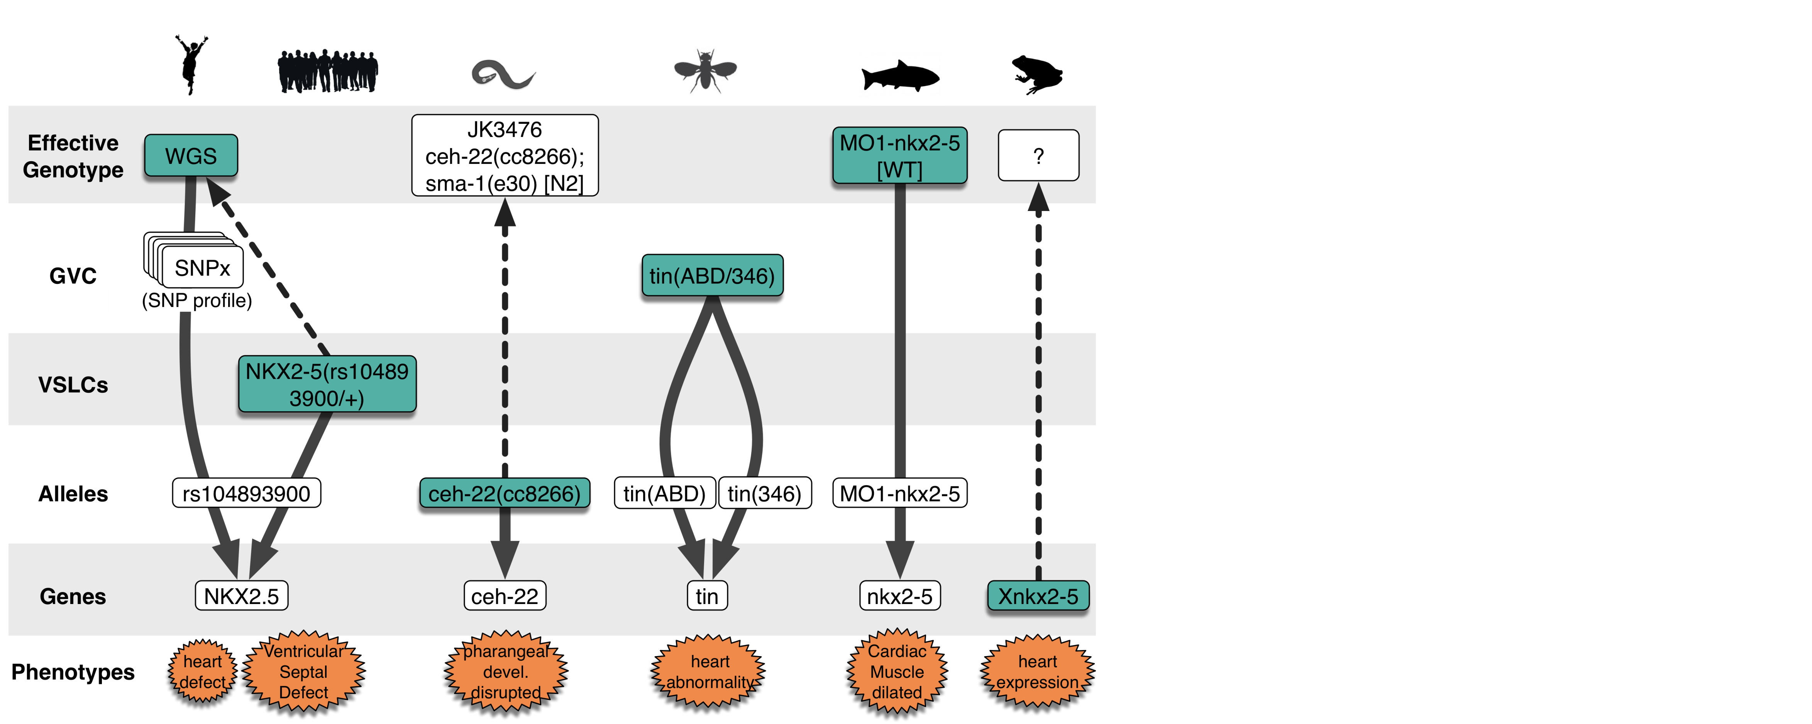
Primary Use Case: Phenotype Propagation
Core genotype partonomy addresses need to compare G2P data across sources that annotate to different levels in a genotype
fgf8a^{ti282a/ti282a};shha^{tbx392/+}[TL]; cdkn1ca^{MO3-cdkn1ca}
Mysm1<tm1a>/Mysm1<tm1a>[C57BL/6]
tin(ABD/346)
daf-2(e1370)
ATP1A3(NM_152296.3)
[c.946G>A, p.Gly316Ser]
Notes:
Phenotype propagation supports ability to retrieve and compare phenotype associations at different levels of the model, across sources

Slide 9
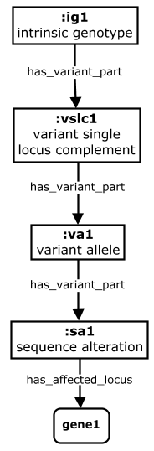
Primary Use Case: Phenotype Propagation
Property chains used to generate inferred phenotype associations
to other parts of the genotype
has_phenotype
gut deformation
fgf8a^{ti282a/ti282a} [TL]
fgf8a^{ti282a/ti282a}
Property Chain
is_variant_part_of o
has_phenotype ->
has_phenotype
fgf8a^{ti282a}
ti282a
fgf8a
Notes:
Note that at present, phenotype propagation as shown above is quite promiscuous – inferring G-P relationships where they might not truly exist. This is especially true for complex (multi-genic) genotypes such as the example above, where more than one gene locus is altered, and it is not clear which locus or loci is responsible for the phenotypes annotated to the complete genotype. Here, a conservative phenotype propagation approach would not infer G-P associations with the fgf8a variants or gene as shown.

Slide 10
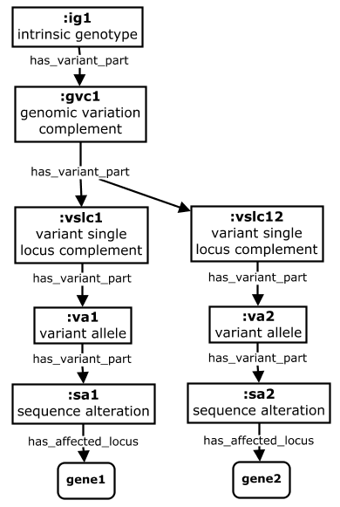
Primary Use Case: Phenotype Propagation
Propagation gets complicated when genotypes to which phenotypes get annotated affect multiple genes
has_phenotype
gut deformation
fgf8a^{ti282a/ti282a};shha^{tbx392/+}[TL]
fgf8a^{ti282a/ti282a};shha^{tbx392/+}
Property Chain
*
is_variant_part_of o
has_phenotype ->
has_phenotype
fgf8a^{ti282a/ti282a} | shha^{tbx392/+}
fgf8a^{ti282a} | shha^{tbx392}
ti282a | tbx392
fgf8a | shha
Notes:
* Note that for complex / multigenic genotypes, it is typically not apparent which single variant/gene causes a given phenotype associated with the genotype. So phenotypes will in most cases not get propagated to separate variants/genes, unless there is corroborating evidence that they alone are causative for the phenotype. Heuristic algorithms are applied to determine when propagation to single variants/genes is acceptable.

Slide 11
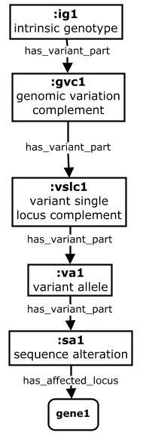

Primary Use Case: Phenotype Propagation
Phenotypes can be propagated ‘up’ a genotype as well, when annotations are made to smaller elements (e.g. alleles)
Property Chains
is_variant_part_of o
has_phenotype ->
has_phenotype
has_variant_part o
has_phenotype ->
has_phenotype
daf-2(e1370) III; fog-2(oz40) V [n2]
daf-2(e1370) III; fog-2(oz40)V
*
daf-2(e1370)III
has_phenotype
gut deformation
daf-2(e1370)
e1370
daf-2
Notes:
An example of propagation ‘up’ (and ‘down’) a genotype – for a wormbase G-P annotation made at the level of the variant allele.
* As with propagation down from complex / multigenic genotypes, caution must be taken to consider genetic interactions when propagating up to complex genotypes that contain variants in addition to the annotated allele.

Slide 12
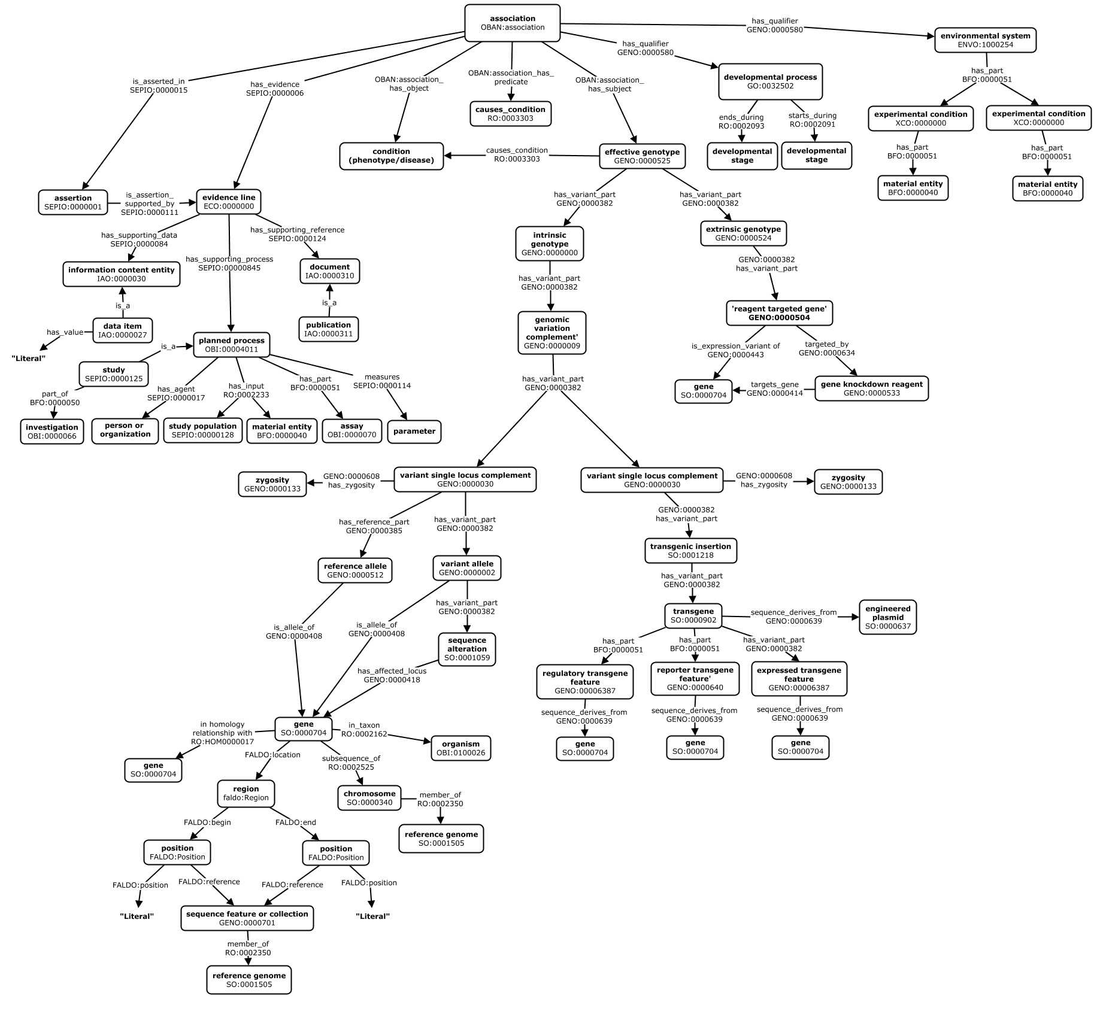
G2P Association Design Patterns in GENO
Association
Model
Developmental Stage
Environment
Evidence
Extrinsic
Genotype
Intrinsic
Genotype
Transgenes
Genes
GENO also supports representation of G2P association data, providing terms and design patterns to support standardized modeling of data from diverse sources.
Genomic
Position
Notes:
The core genotype partonomy is complemented by additional content that supports complete description of G2P associations..
Shown here is an abstract view of the design patterns it supports in modeling data ingested as rdf into the Monarch ‘SciGraph’ database.
Above is a 30000 ft view to give a sense of coverage – shown here colored according to different topics or ‘motifs’.
At core are the intrinsic and extrinsic genotype partonomies (green) representing the elements of genetic variation to which phenotypes and diseases are annotated.
The remaining patterns represent the association itself which is modeled according to the OBAN reification model (blue), its contextualizing environment (purple) and developmental stage (brown) information, evidence and provenance related metadata for the association (orange), and metadata about the genes affected in the genotype (red)

Slide 13
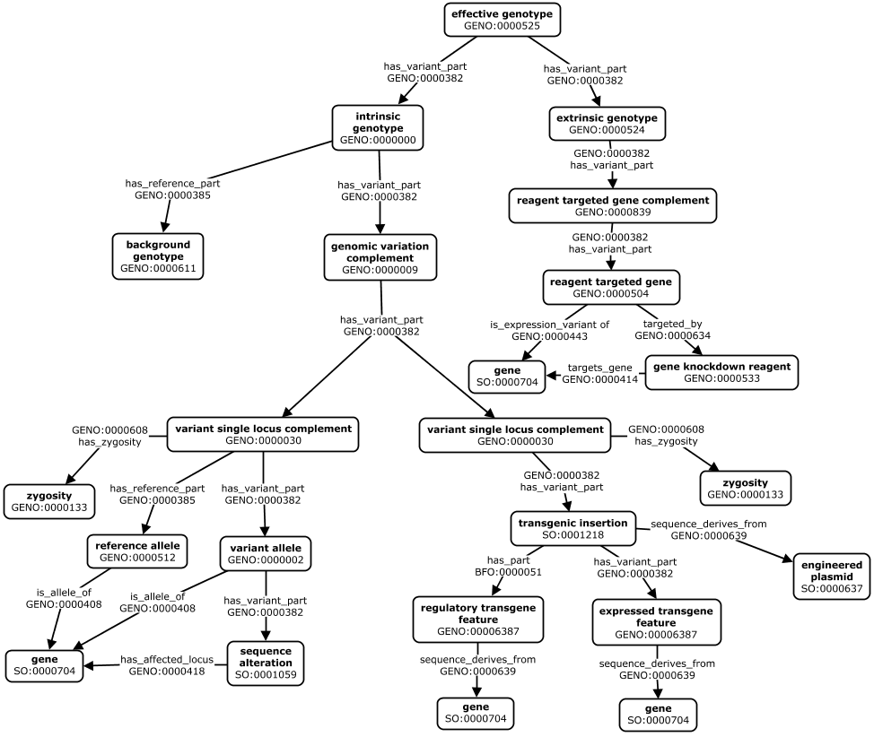
Intrinsic and Extrinsic Genotype Partonomies
*
Notes:
* Note that we are refining our representation of transgenes – an ongoing area of work in collaboration with other model organism databases.

Slide 14
Decomposition of an Effective Genotype
shha^{tbx392/+}; i114Tg/? [TL]; cdkn1ca^{MO3-cdkn1ca}
shha^{tbx392/+}; i114Tg/? [TL]
cdkn1ca^{MO3-cdkn1ca}
cdkn1ca^{MO3-cdkn1ca}
[TL]
shha^{tbx392/+};
i114Tg/?
cdkn1ca^{MO3-cdkn1ca}
MO3-cdkn1ca
shha^{tbx392/+}
i114Tg/?
cdkn1ca
heterozygous
unspecified
i114Tg
shha⁺
shha^{tbx392}
p-i114Tg
shha
tbx392
mpx
gfp
Notes:
Example shows an effective genotype from ZFIN comprised of:
an intrinsic genotype with two variant single locus complements: a heterozygous mutation of the shha gene, and a random integration of the i114Tg transgene (a gfp reporter driven by the promoter of the mpx gene).
an extrinsic genotype with a single gene (cdkn1ca) targeted by a morpholino reagent (MO1-cdkn1ca)

Slide 15
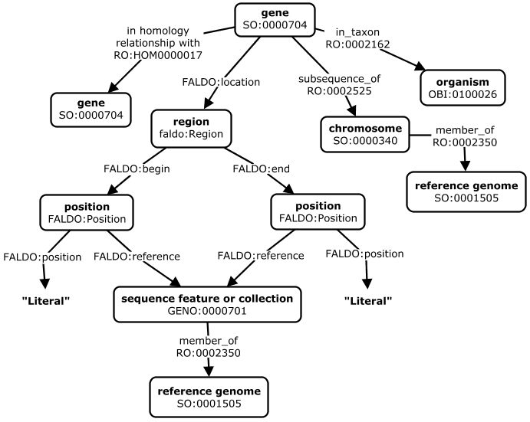
Gene Descriptions

Slide 16
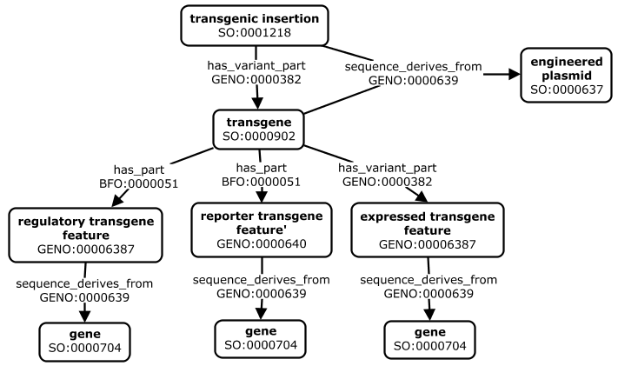
Transgenes
*
Notes:
* Note that we are refining our representation of transgenes – an ongoing area of work in collaboration with other model organism databases.

Slide 17
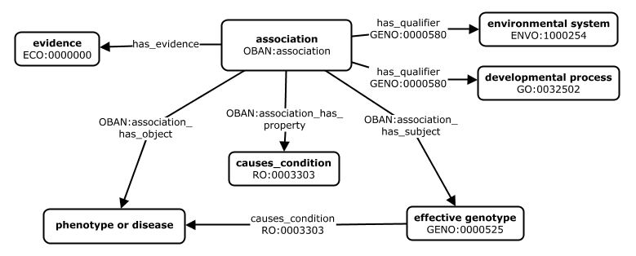
Reified Associations
Notes:
based on OBAN model, extend with qualifiers for n-ary relationships
identity criteria = subject, object, qualifiers (environment, developmental stage).
Evidence is not identity criteria

Slide 18
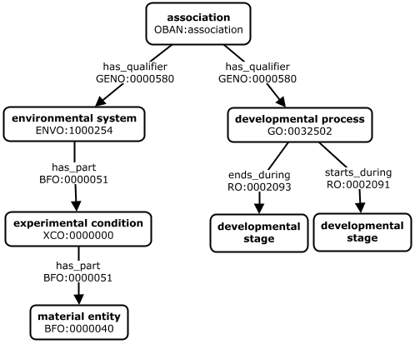
Association ‘Qualifiers’
Environment
Developmental
Stage

Slide 19
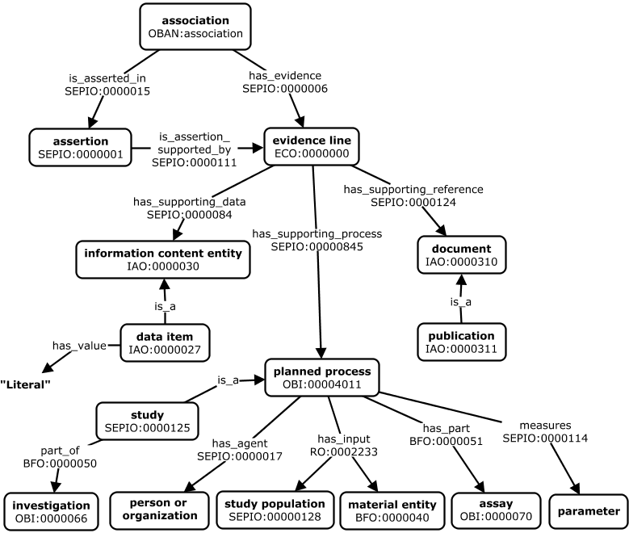
Evidence and Provenance*
Notes:
* Very outdated – need to update

Slide 20
Workflow for and Documentation Ingesting GENO-Compliant Models
Source data explored and modeled
Data mapped to existing GENO patterns where possible
Existing patterns refine, new patterns defined
Data model implemented in DIPper code
DIPper executed to transform source data according to the model
Data QA and evaluation → iterative model refinement
Ingest of subsequent sources often required update of models for existing sources

Slide 21
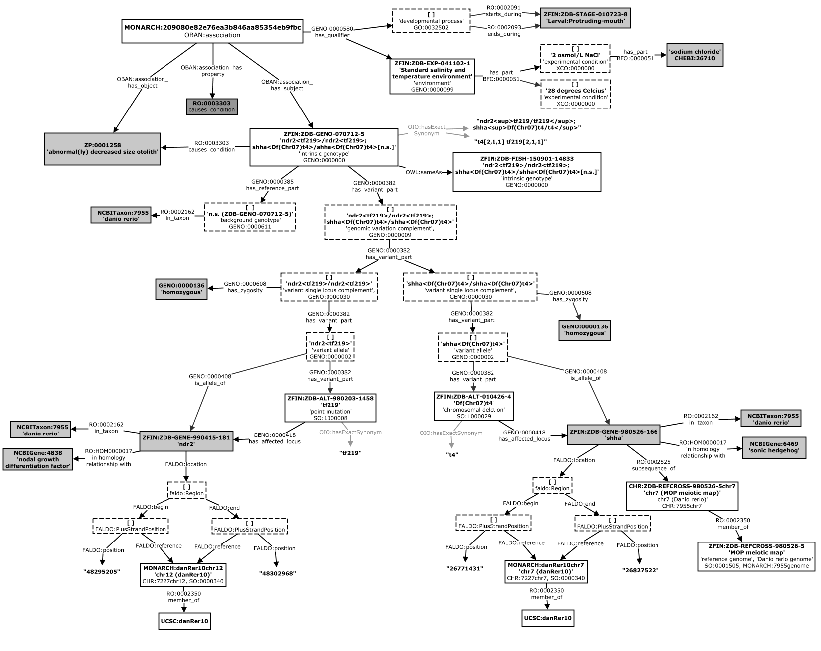
Graphical Concept Maps Specify Data Models for Each Source
ZFIN Example 1:
http://zfin.org/ZDB-FISH-150901-14833
A genotype-phenotype association for an intrinsic genotype comprised of homozygous mutations in two genes (ndr2 and shha), qualified by both environment and developmental stage information.
Notes:
To facilitate communication and collaborative development of a coherent set of data models across sources, we create concept maps according to a carefully defined notation and syntax. These provide formal specification of design patterns that effectively serve as a schema for data in SciGraph – ensuring consistent representation of data across sources in compliant with the GENO standard. We create one of these maps for each source of data we pull into the system, and each specifies all possible patterns found in the data. Goal of the formal syntax is to specify unambiguously all nuances and features of rdf and owl languages (needed to produce GENO-compliant ttl through the DIPper pipeline) (needed to define python code that produces consistently structured ttl data through the DIPper pipeline) (needed to completely specify our data models). A key describing the syntax and notation is on an upcoming slide.
This is a simple example for a ZFIN G2P association made at the level of an intrinsic genotype, which is comprised of homozygous mutations in two genes (ndr2 and shha), qualified by both environment and developmental stage information. Explore the source data starting with the URL here: http://zfin.org/ZDB-FISH-150901-14833 – to get a sense for how source G2P data from ZFIN is represented using the DIPper model shown above.
-----
Evidence/provenance metadata omitted from this example.

Slide 22
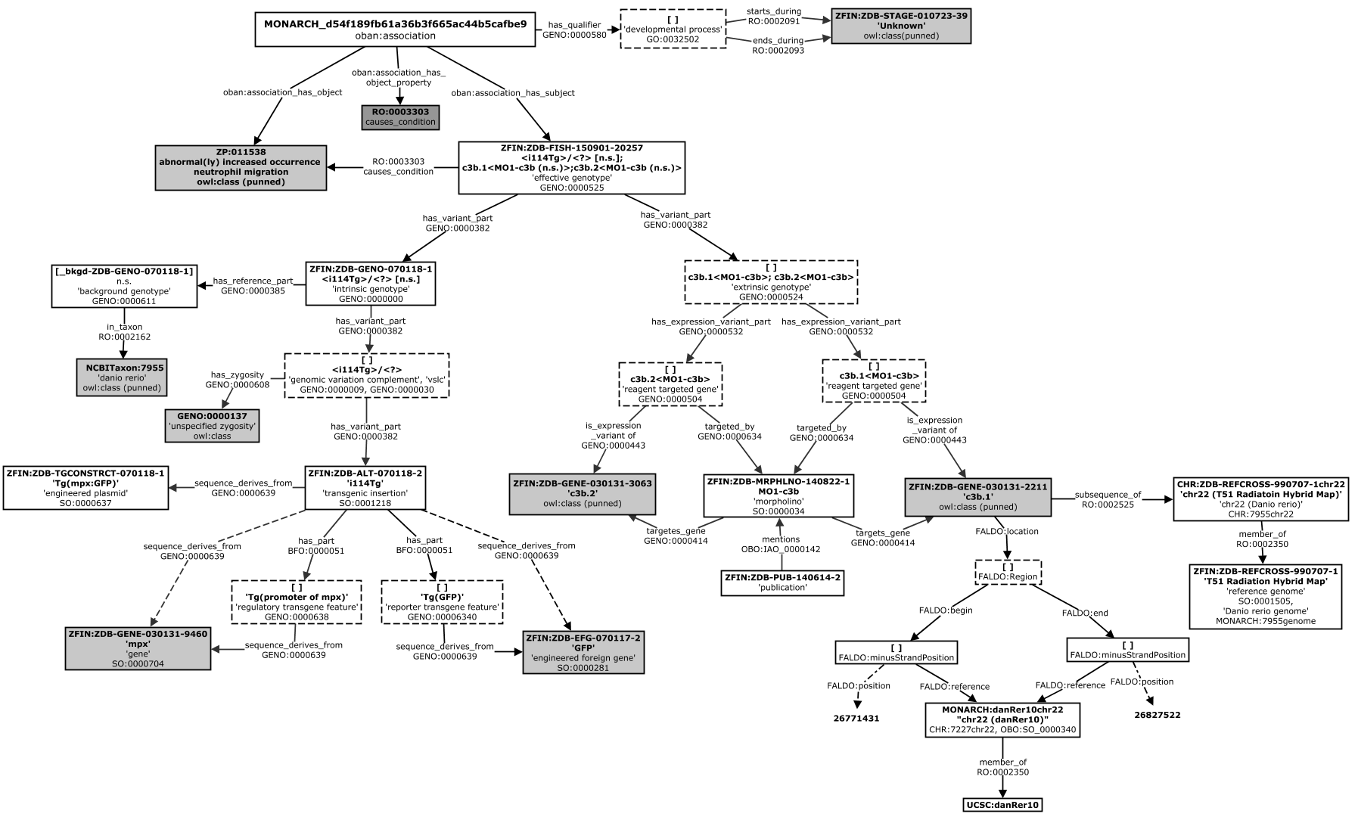
Graphical Concept Maps Specify Data Models for Each Source
ZFIN Example 2:
http://zfin.org/ZDB-FISH-150901-20257
A genotype-phenotype association for an effective genotype comprised of an intrinsic genotype component containing an unlocated transgenic insertion (i114Tg) which drives GFP expression from the promoter of the mpx gene, and an extrinsic genotype component that contains two reagent-targeted genes (c3b.1 and c3b.2) targeted by the same morpholino (MO3-zic2a)
.
*
**
Notes:
Here is another example of a ZFIN genotype-phenotype association for an effective genotype comprised of an intrinsic genotype component containing an unlocated transgenic insertion (i114Tg) which drives GFP expression from the promoter of the mpx gene, and an extrinsic genotype component that contains two reagent-targeted genes (c3b.1 and c3b.2) targeted by the same morpholino (MO3-zic2a). Explore the source data starting with the URL here: http://zfin.org/ZDB-FISH-150901-20257 – to get a sense for how source G2P data from ZFIN is represented using the DIPper model shown above.
* Note that when there is only one altered locus in the intrinsic genotype, the genomic variation complement (GVC) and variant single locus complement (VSCL) are the same.
** Note that we are refining our representation of transgenes – an ongoing area of work in collaboration with other model organism databases.

Slide 23
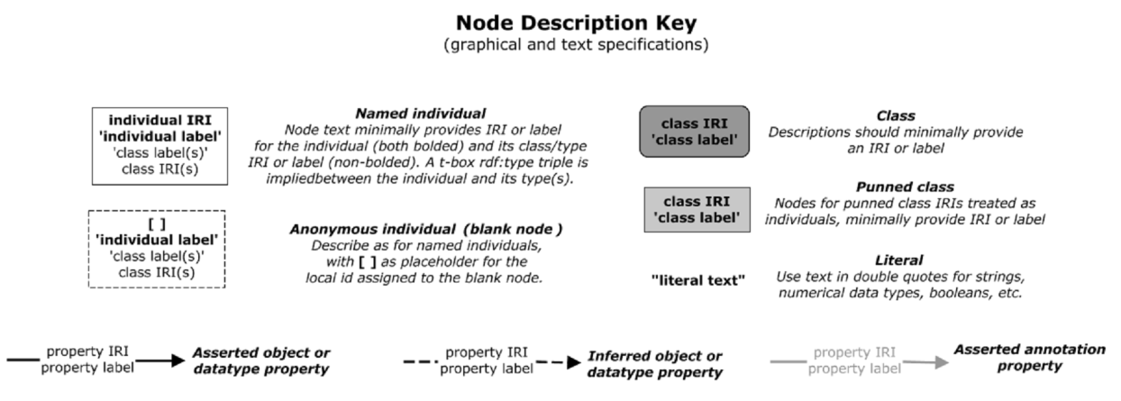
Graphical Concept Maps Specify Data Models for Each Source

Slide 24
Cmap Documentation Supports Different Users and Use Cases
Monarch Developers
Provides shared view of the domain for ontologists, coders, and domain experts to collaboratively develop and implement models
Ensures consistent representation of similar data cross sources
Monarch Application Users
Gives overall sense of data and relationships they can navigate and query in the system
Third Party Data Scientists and Developers
Provides technical understanding of the data needed to query over, operate on, and integrate data for diverse use cases

Slide 26
Genotype Partonomy
An ‘intrinsic’ genotype is decomposed into its more fundamental components of variation. These represent the ‘levels’ of a genotype at which phenotype associations are made.
Specifies the total variation in genomic sequence or gene expression across a genome.
fgf8a^{ti282a/ti282a};shha^{tbx392/+}[TL]; cdkn1ca^{MO3-cdkn1ca}
*
Specifies sequence variation across an entire genome in terms of its differences from some genomic background.
fgf8a^{ti282a/ti282a};shha^{tbx392/+}[TL]
The variant portion of a genome, comprised of all allelic complements containing at least one variant allele.
fgf8a^{ti282a/ti282a};shha^{tbx392/+}
**
The set of all alleles at a locus where at least one is variant
fgf8a^{ti282a/ti282a}
A single locus that contains a sequence alteration
fgf8a^{ti282a}
A single locus whose extent is the deviation from a reference .
ti282a
A locus containing all elements needed to produce functional gene product
fgf8a
Notes:
Definitions and examples for each level in the genotype partonomy.
* This cdkn1ca^{MO3-cdkn1ca} variant is a morpholino-targeted gene that is part of the extrinsic genotype. The breakdown in this figure shows only decomposition of the intrinsic genotype. Modeling of the extrinsic genotype is detailed in subsequent slides.
** As before, we show only the breakdown of variation for only one of the two affected genes (fgf8a), but variation at the shha locus would be similarly modeled.
GENO models genotype ‘content’ with relatively precise granularity (i.e. explicit representation of distinct ‘levels’ of variation, and partonomic relationships between them) relative to other approaches. For example, Flybase treats genotypes merely as ‘bags of alleles’ – forgoing explicit representation of each level above. The GENO model is built this way to support two key use cases. The first is related to integration of G2P data across diverse systems and species – where phenotypes may be asserted at each of the levels of genetic variation described in the partonomy above. The second concerns the need to ‘propagate’ phenotypes up and/or down this partonomy – i.e. inferring associations between phenotypes and variant entities other than that where the phenotype as asserted to hang.

